Slide 1
Predicting Crop Yield using Soil and Climate
Amit Tiwari
U02796114

Slide 2
Project Objective
What are the primary environmental and temporal factors driving yield variability across the dataset, and how dominant are soil properties compared to climatic factors (weather).
What are the directional impacts of specific soil health indicators—such as Soil pH (phh2o) and Clay Content—on predicted yield?
How does the impact of weather factors (e.g., Temperature, Humidity, Solar Radiation) differ in predictability between high-accuracy crops (Foodgrains) and lower-accuracy crops (Oilseed)?

Slide 3
Data Sources
Yield Data – icrisat.org
Downloaded the data for foodgrains, oilseed and cereals for respective districts for each state for year 2001 - 2023
Geospatial Coordinates – geopy library (based on OpenStreetMap)
Using this python library fetched the latitude and longitude of the districts
Weather Data – NASA api
Using the lat/long data fetched the average weather for the districts
Soil Data – Open EPI
Using the lat/long data fetched the average soil condition for the districts

Slide 4
Variation in Soil Properties
Does not vary with time within a single district.
Shows spatial variation across different districts.
Soil ph and clay content are critical feature impacting yield.
Soil ph determines how well crops absorb nutrients. It should not be too acidic or alkaline
Clay content determines water holding capacity of soil.

Slide 5
Variation in Weather
Foodgrains – Average temperature was the most important feature.
Cereals – Average temperature and average humidity were the most important feature.

Slide 6
Model Comparison
 | Foodgrains |  | Cereals |  | Oilseeds
 | Random Forest | Linear Regression | Random Forest | Linear Regression | Random Forest | Linear Regression
RMSE | 0.38 | 0.78 | 0.48 | 0.48 | 0.94 | 1.41
R2 | 0.83 | 0.32 | 0.77 | 0.77 | 0.59 | 0.09

Slide 7
Why Random Forest performed better
Handles Non-Linear Relationships
Crop yield does not increase linearly with inputs.
Example: Fertilizer improves yield only up to an optimal point, after which yield plateaus or even declines (inverted U-shape).
Captures Threshold Effects
Some variables boost yield only within specific ranges.
Example: Yield may drop sharply when temperature crosses a critical threshold, even if rainfall is adequate.
Models Complex Interactions
The impact of one factor often depends on another.
Example: High rainfall can be beneficial on sandy soils but harmful on clay soils.
Linear Regression cannot effectively capture these interaction patterns, while Random Forest can.

Slide 8
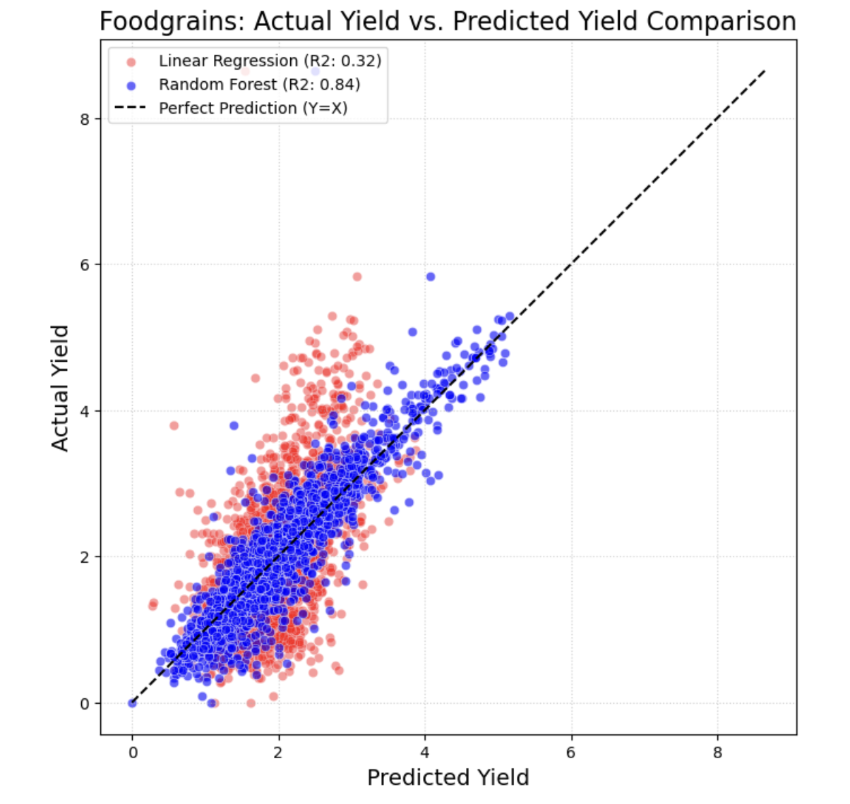
Performance for Food Grains
The Random Forest model (R2=0.84) provides an excellent for the foodgrain data, with the blue data points tightly clustered around the perfect prediction line (Y=X).
The difference in performance between Random Forest and Linear Regression (R2=0.32) confirms that the relationship between input features and foodgrain yield is highly non linear.

Slide 9
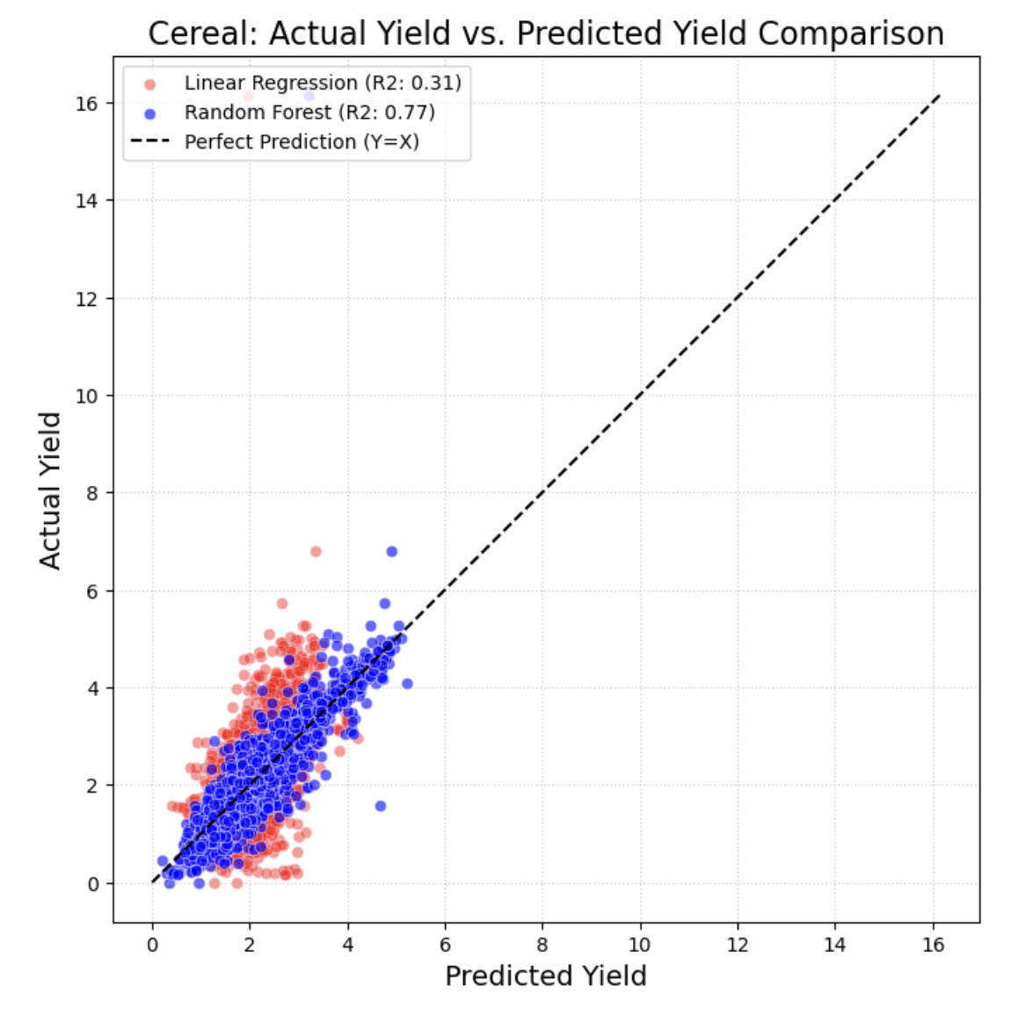
Performance for Cereals
The Random Forest model (R2=0.77) provides an excellent for the cereals data, with the blue data points tightly clustered around the perfect prediction line (Y=X). than the Linear Regression model ($R^2=0.31$). This confirms that the factors influencing cereal yield are non linear
Features in the dataset account for a larger proportion of the variance in foodgrain yield than in cereal yield.

Slide 10
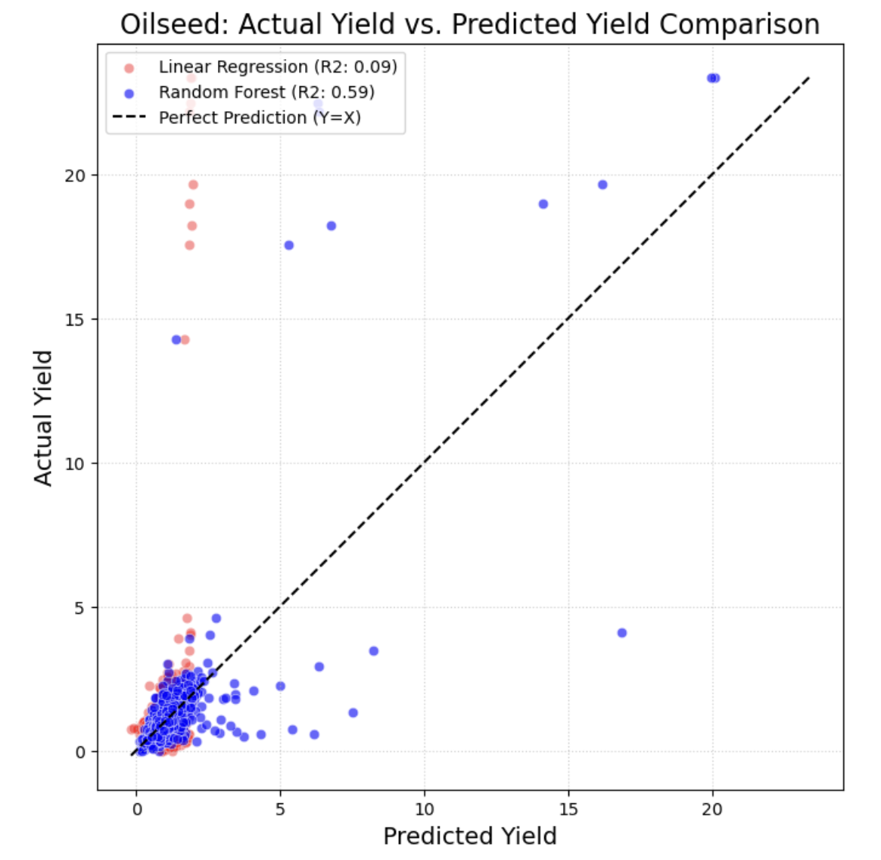
Performance for Oilseed
Despite the Random Forest improvement, the blue data points are much more scattered and exhibit a larger spread away from the perfect prediction line (Y=X) than the Foodgrains model. This indicates that a significant amount of the variance in oilseed yield (the remaining 41%) is unexplained by the current features in the dataset, suggesting higher noise or missing variables.

Slide 11
SHAP summary plot
Horizontal Stretch (X-axis)
Shows impact strength.
Right = increases prediction, Left = decreases prediction.
Wider spread = feature has higher variation in influence.
Vertical Position (Y-axis)
Features are ranked by importance (top = most important).
Color Coding
Red = high feature value, Blue = low feature value.
Shows whether high or low values push predictions up or down.
Positive vs Negative Values
Positive SHAP → pushes prediction up.
Negative SHAP → pushes prediction down.

Slide 12
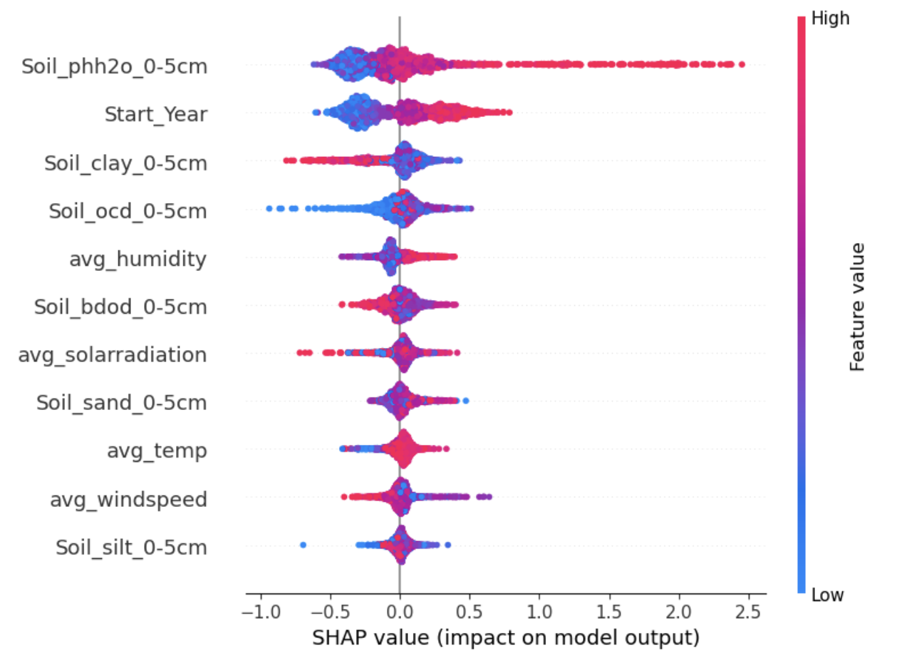
Feature Importance for Food grains
The high R2=0.84 for foodgrains is primarily driven by the model's ability to utilize soil characteristics (pH, clay, organic carbon) as the main predictive factors, with climatic variables playing a lesser role. This suggests that soil management and inherent soil quality are the most critical determinants of yield variability captured by the model.

Slide 13
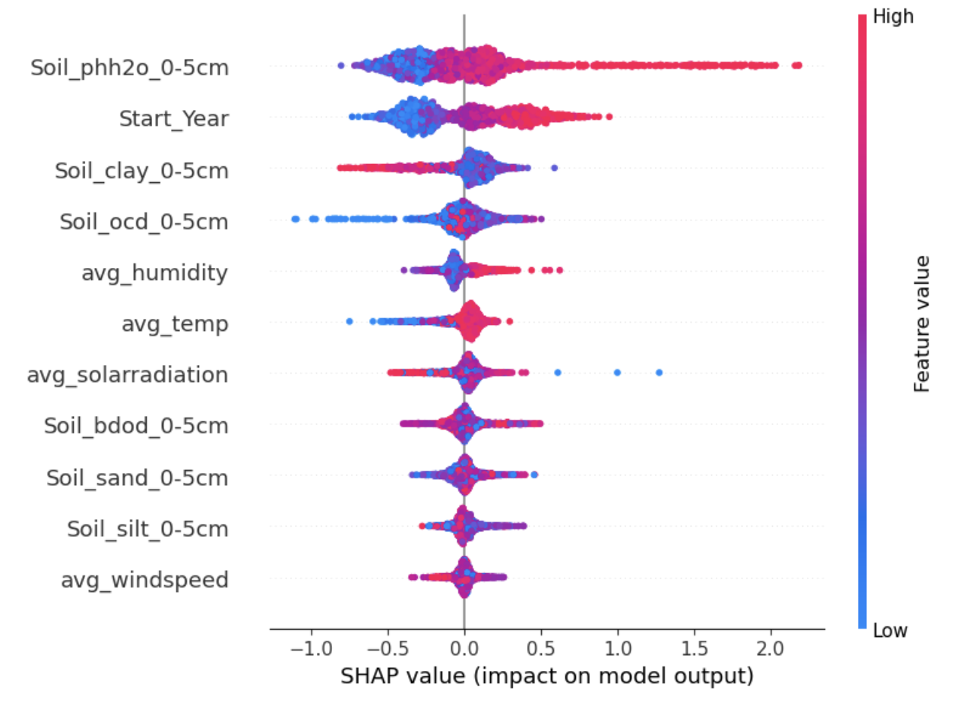
Feature Importance for Cereals
The horizontal spread is slightly lesser than foodgrain which shows bit less influence on prediction.
The data points for Cereal on the Actual vs. Predicted plot are more scattered than those for Foodgrains. This suggests that the SHAP plot for Cereal would show more vertical scatter within each feature band. This increased scatter implies that the effect of a specific feature value is less consistent compared to Foodgrain instances, making the Cereal model less reliable.

Slide 14
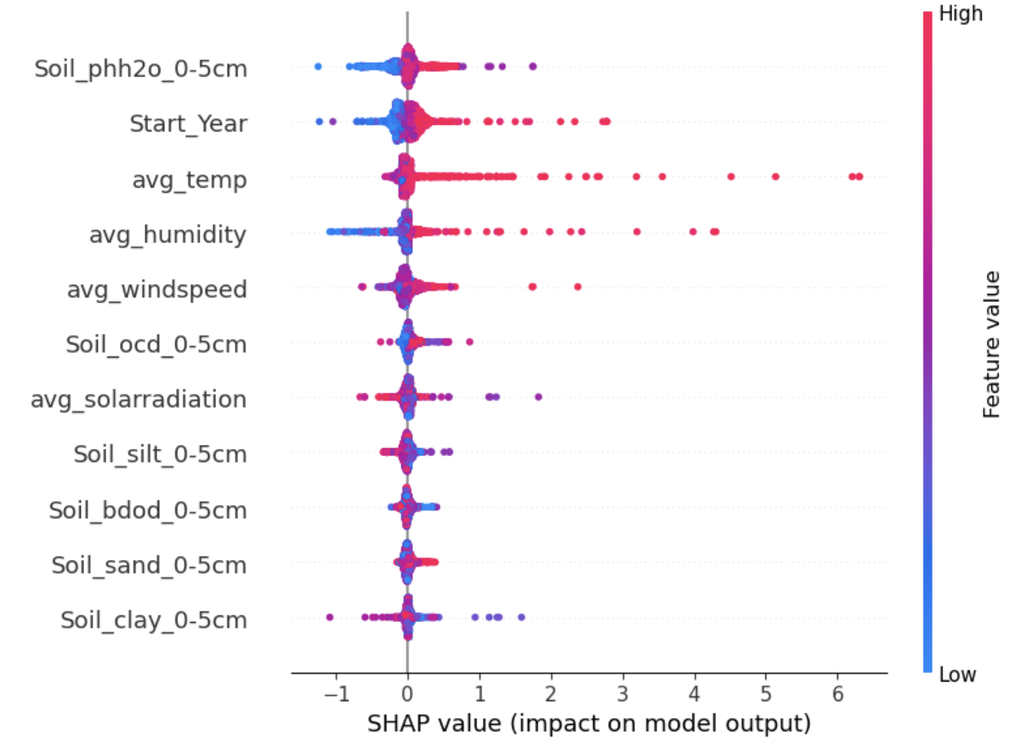
Feature Importance for Oilseed
Properties of the topsoil layer are the primary factors for yield. High Soil pH and high ocd positively impact predicted oilseed yield.
The top features have a much weaker predictive influence on Oilseed yield compared to Foodgrains.
The lower R2 for Oilseed is primarily because its yield is less responsive to the available features and the relationship is less consistent (higher scatter). The drivers are similar to Foodgrains, but the features explain less of the outcome.

Slide 15
Conclusion
Dominance of Soil Properties over Climatic Factors
Soil is the Primary Driver: Across all crop categories analyzed (Foodgrains, Cereal, and Oilseed), soil properties are the most dominant and consistent factors for predicting yield.
SHAP Analysis Confirms: Features related to the topsoil layer (0-5cm), specifically Soil pH (phh2o), Start_Year (as a proxy for long-term changes), and Soil Clay content, consistently rank highest in importance.
Climatic Factors: Climatic features (average temperature, humidity, windspeed) generally rank lower in the SHAP analysis, suggesting that the macro-level weather data available is less predictive of yield variability than the static and chemical properties of the soil.

Slide 16
Conclusion contd.
Directional Impacts of Key Soil Health Indicators
The models reveal clear directional relationships crucial for land management:
Soil pH (phh2o): Higher values of Soil pH (red dots) have a strong, positive impact on predicted yield. Conversely, low pH (blue dots) significantly pushes the yield prediction lower.
Soil Organic Carbon (ocd): High Organic Carbon Density (red dots) consistently shows a positive impact on yield, highlighting its importance for overall soil health and fertility.
Soil Clay and Bulk Density: Low Clay Content (blue dots) has a strong negative impact, while high Bulk Density (bdod) (red dots) also pushes yield predictions lower.

Slide 17
Conclusion contd.
Differences in Predictability (High vs. Low Accuracy Crops)
The predictive power of all features is highly crop-dependent:
High-Accuracy Crops (Foodgrains): The model is highly confident (R2=0.84) because the primary drivers (Soil pH, Clay) have a stronger and more consistent impact on Foodgrains yield.
Lower-Accuracy Crops (Oilseed): The model is less accurate (R2=0.59) because the top features have a weaker overall predictive magnitude and a higher degree of inconsistency (scatter).
Implication: This suggests that the yield of Oilseed is more sensitive to either unmeasured variables (e.g., pests, micro-climates, specific management actions) or critical extreme weather events that were not captured effectively by the averaged climatic features.

Slide 18
How to improve
Capturing the data more granularly like mentioning the specific food grain or cereal to know the specific growing season and considering the average weather for that season.
Soil and weather are considered for the specific location rather than the district.
Considering the factors like use of fertilizers, hybrid seeds, micronutrient.

Slide 19
Thank You

